Slide 1
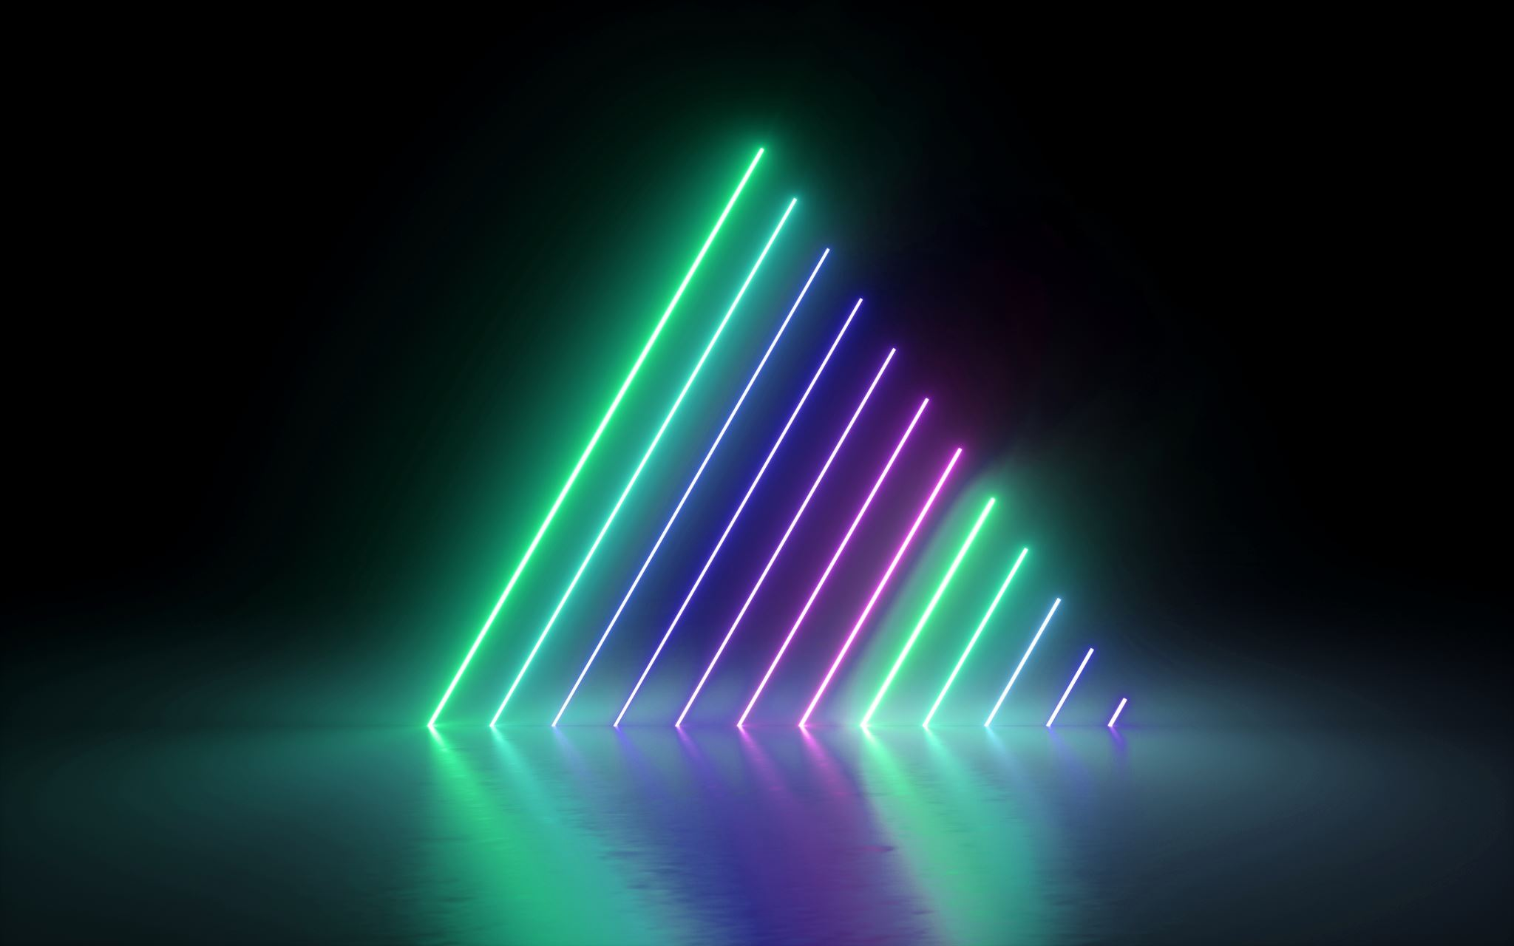
WebGl Model Viewer Project
Gazi University – Computer Graphics
Mustafa Sina Yıldırır

Slide 2
Purpose of the project
Purpose of the Project is provide a 3d model viewer that have these options:
Obj Importing (OBJ Parser)
Texture Importing
Framebuffer visualization
The base of the deferred rendering
Spot Light, Point Light, Directional Light
Object Outliner with transformation.

Slide 3

THE User INTERFACE

Slide 4
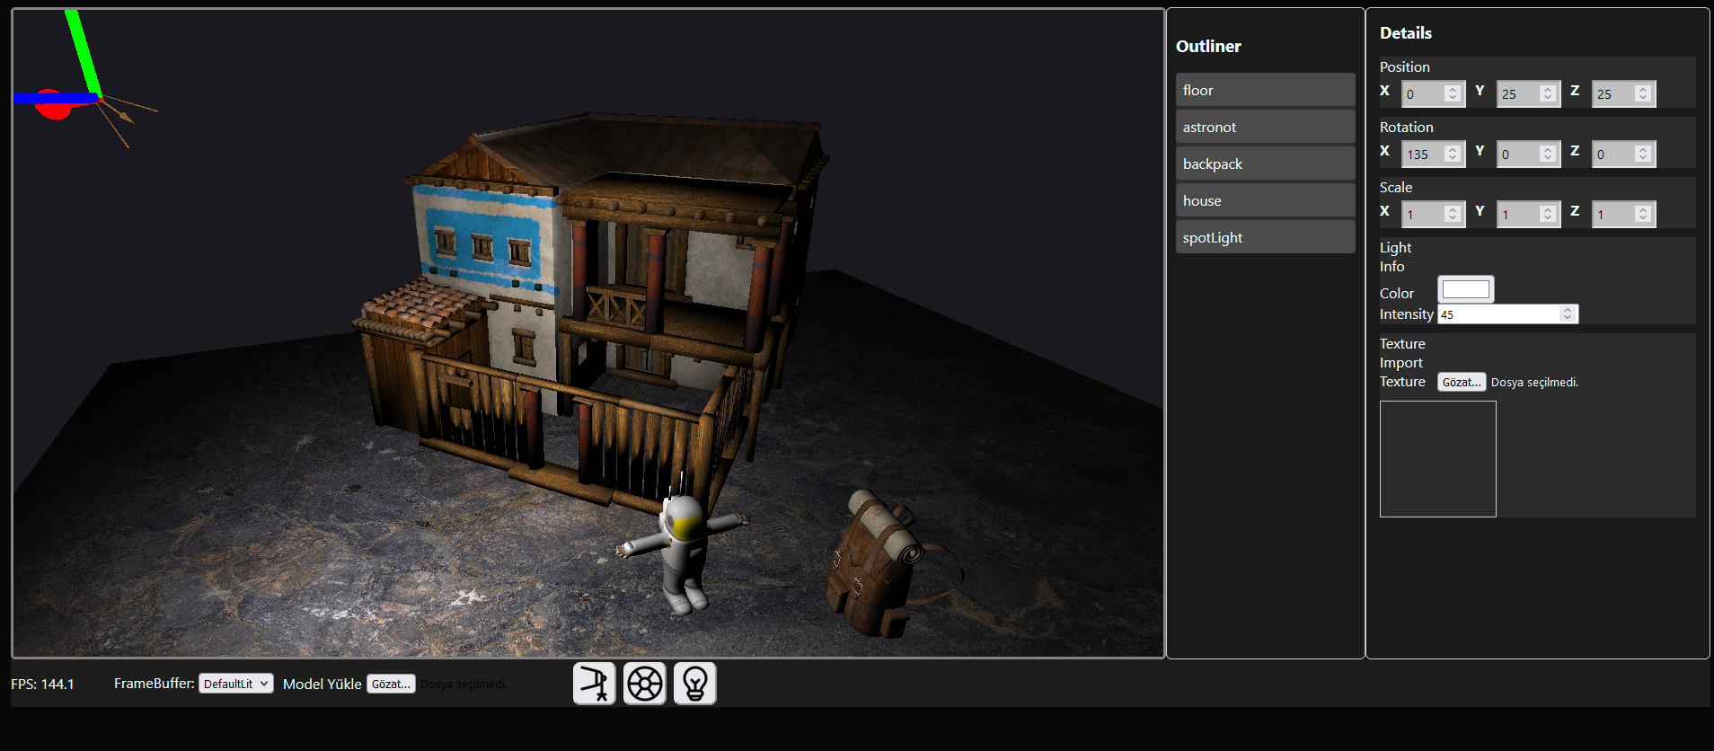
THE User INTERFACE

Slide 5
THE User INTERFACE

Slide 6
OUTLINER
- You can see the list of the models in the scene with outliner.

Slide 7
THE User INTERFACE

Slide 8
DETAILS PANEL
When you click a object in the outliner you can see the details of object.
Also you can edit the settings of a object.
You can set position, rotation and scale attirbutes.
If a selected object is a light you can edit color of light and intesity (power) of light.
The Texture import section of details panel is give a chance to import a texture and apply it to the diffuse color of a object.

Slide 9
THE User INTERFACE

Slide 10
THE User INTERFACE
FPS shows the frame per second in the webgl context.

Slide 11
THE User INTERFACE
FrameBuffer shows the buffers that I setted.
Default Lit | Unlit | Depth
Shows the final image of the scene with lighting | Shows the diffuse colors of the scene. | Shows the depth as a texture value red.

Slide 12
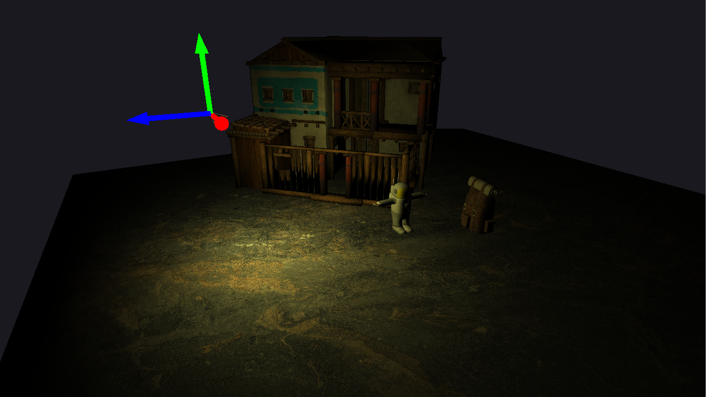
DEFAULT LIT

Slide 13
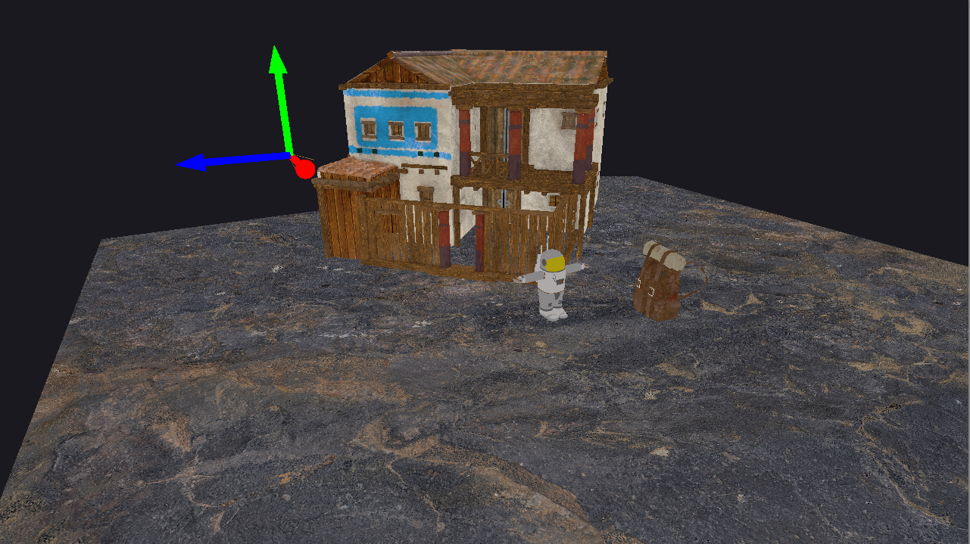
UNLIT

Slide 14
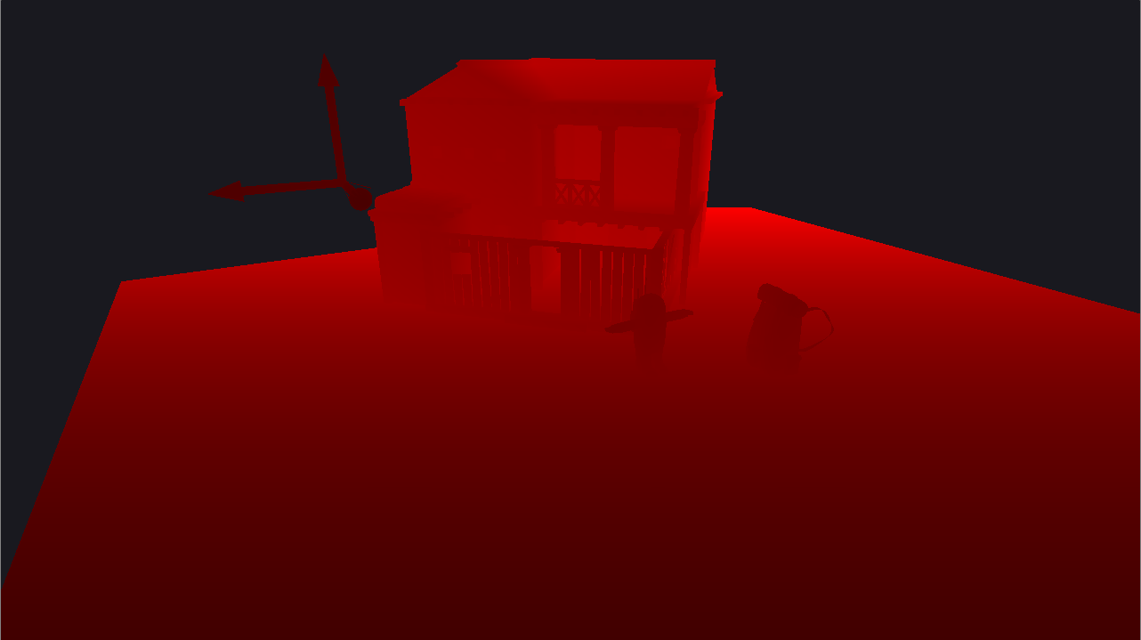
DEPTH

Slide 15
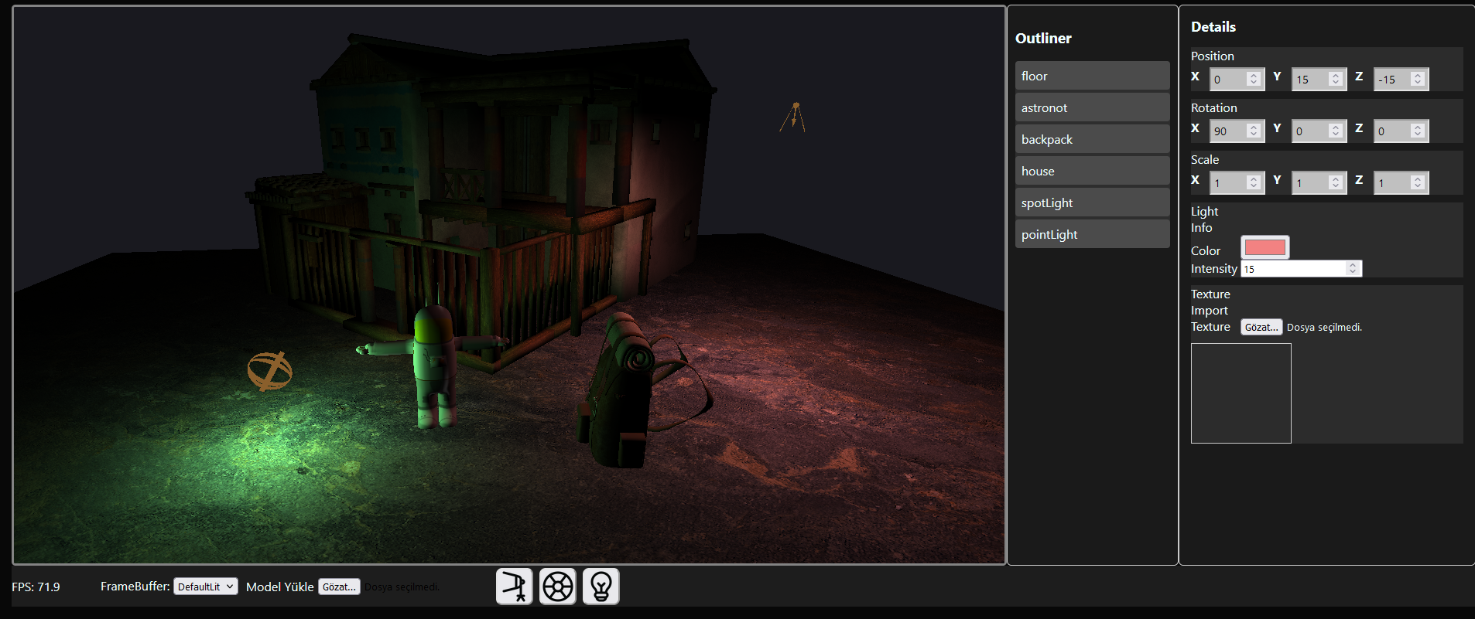

THE User INTERFACE
- You can add one spotlight, one point light and one directional light to scene.

Slide 16
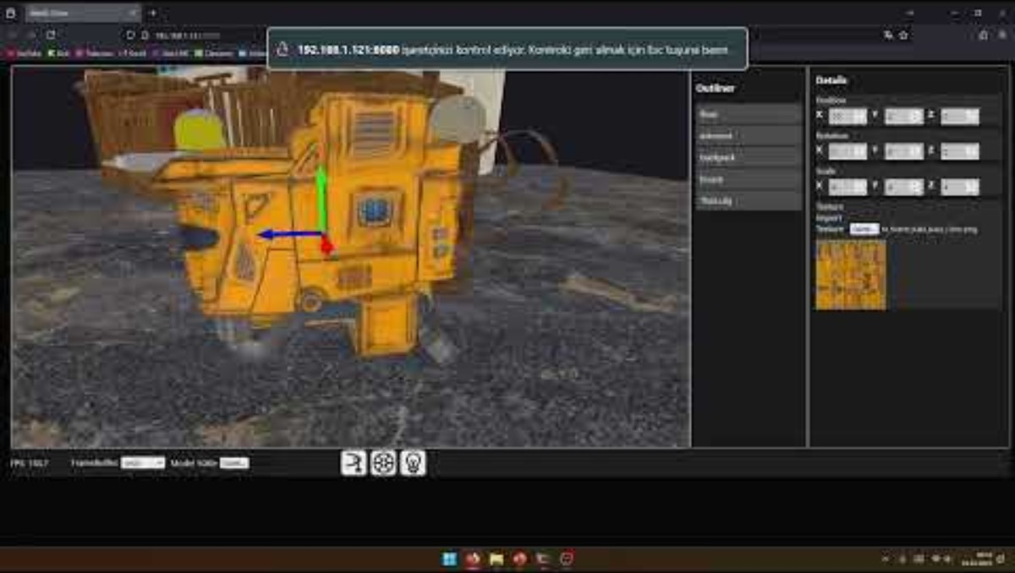
VIDEO PRESENTATION OF WEBSITE

Slide 17
THANKS FOR LISTENING
CLICK FOR VISIT WEBSITE

